Slide 1
Programming II
(C Programming Language)
Arrays in C
(Part II)
Lecture 12, Wednesday March 03, 2021
Dr. Ayman ALJARBOUH

Slide 2
Outline
Multi-Dimensional Arrays
Two-Dimensional Arrays
Initializing Two-Dimensional Arrays
Accessing Two-Dimensional Arrays
Pass Array to Function in C

Slide 3

Multi-Dimensional Arrays
C programming language allows multidimensional arrays. That is, in C programming, you can create an array of arrays
These arrays are known as multidimensional arrays
Following is the general form of a multidimensional array declaration
For example,
Here, x is a two-dimensional array. The array can hold 12 elements. You can think the array as a table with 3 rows and each row has 4 columns.

Slide 4
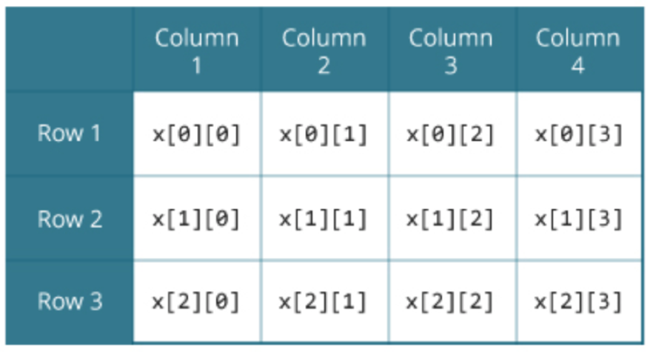
Multi-Dimensional Arrays
For example,
Here, x is a two-dimensional array. The array can hold 12 elements. You can think the array as a table with 3 rows and each row has 4 columns.

Slide 5

Multi-Dimensional Arrays
Similarly, you can declare a three-dimensional (3d) array
For example,
Here, the array y can hold 24 elements

Slide 6
Outline
Multi-Dimensional Arrays
Two-Dimensional Arrays
Initializing Two-Dimensional Arrays
Accessing Two-Dimensional Arrays
Pass Array to Function in C

Slide 7

Two-Dimensional Arrays
The simplest form of the multidimensional array is the two-dimensional array
A two-dimensional array is, in essence, a list of one-dimensional arrays
To declare a two-dimensional integer array of size x, y you would write something as follows:
The type can be any valid C data type
The arrayName must be a valid C identifier

Slide 8
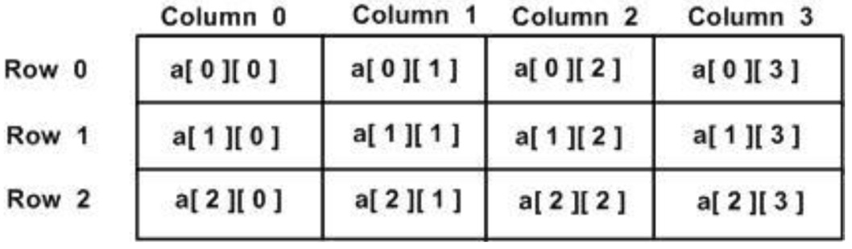
Two-Dimensional Arrays
A two-dimensional array can be think as a matrix which will have x number of rows and y number of columns.
A 2-dimentional array a, which contains 3 rows and 4 columns can be shown as below:
Every element in array a is identified by an element name of the form a[i][j], where a is the name of the array, and i and j are the subscripts that uniquely identify each element in a

Slide 9
Outline
Multi-Dimensional Arrays
Two-Dimensional Arrays
Initializing Two-Dimensional Arrays
Accessing Two-Dimensional Arrays
Pass Array to Function in C

Slide 10
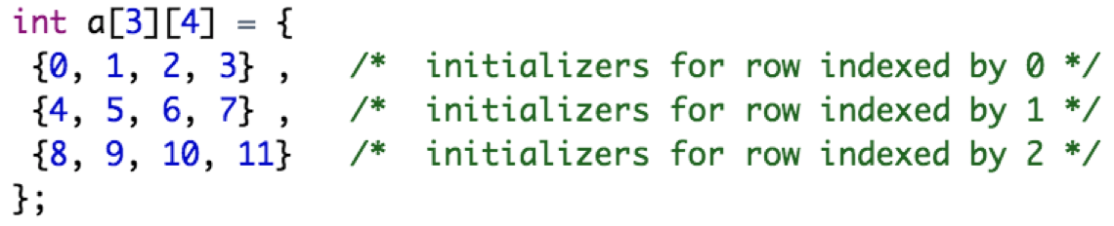
Initializing Two-Dimensional Arrays
Multidimensional arrays may be initialized by specifying bracketed values for each row
Following is an array with 3 rows and each row has 4 columns:
The following initialization is equivalent to previous example

Slide 11
Outline
Multi-Dimensional Arrays
Two-Dimensional Arrays
Initializing Two-Dimensional Arrays
Accessing Two-Dimensional Arrays
Pass Array to Function in C

Slide 12

Accessing Two-Dimensional Arrays
An element in 2-dimensional array is accessed by using the subscripts, i.e., row index and column index of the array
For example:
The above statement will take 4th element from the 3rd row of the array
You can have arrays with any number of dimensions, although it is likely that most of the arrays you create will be of one or two dimensions

Slide 13
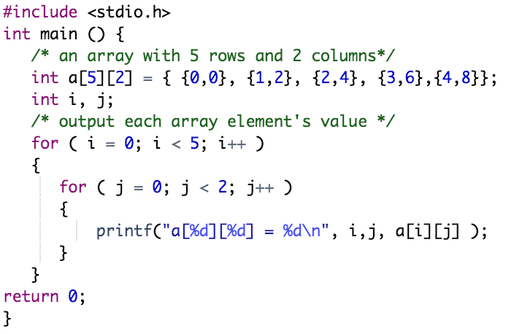
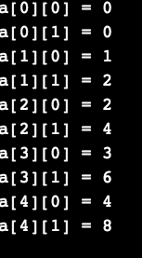
Accessing Two-Dimensional Arrays
Example:

Slide 14
Outline
Multi-Dimensional Arrays
Two-Dimensional Arrays
Initializing Two-Dimensional Arrays
Accessing Two-Dimensional Arrays
Pass Array to Function in C

Slide 15
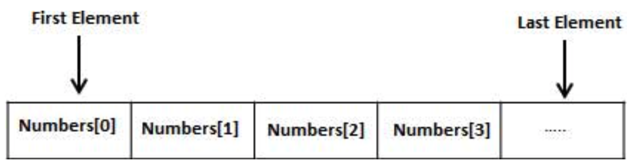
Pass Array to Function in C
Just like variables, array can also be passed to a function as an argument
There are many ways of passing arrays to a Function in C:
Passing array to function using call by value method:
In this case, the actual parameter is copied to the formal parameters
Passing array to function using call by reference method:
This is done by passing the address of the array to the function as an argument, the function declaration should have a pointer as a parameter to receive the passed address
Also, you may pass the name and the size of the array to a function as arguments

Slide 16
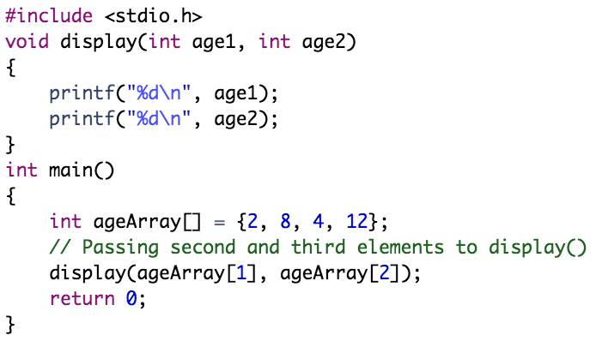
Pass Array to Function in C
Example:
call by value

Slide 17
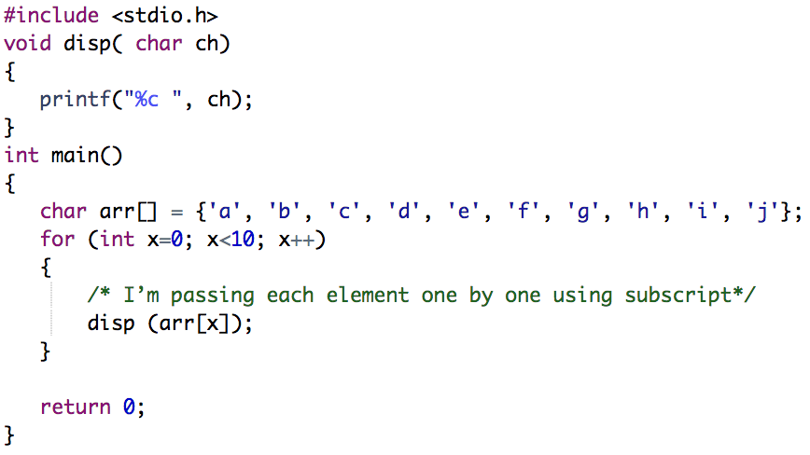
Pass Array to Function in C
Example:
call by value

Slide 18
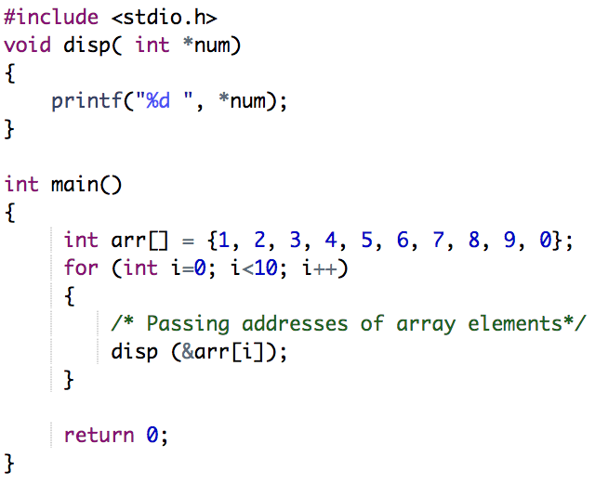
Pass Array to Function in C
Example:
call by reference

Slide 19
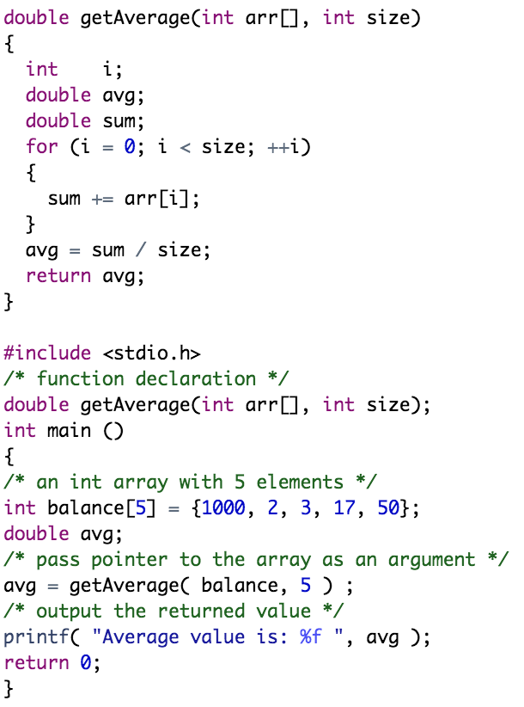
Example:
Passing name and size of the array
to the function as arguments

Slide 20
Practical Exercises
Write and Compile the following C programs:
Program 1:

Slide 21
Practical Exercises
Write and Compile the following C programs:
Program 2:

Slide 22
Practical Exercises
Write and Compile the following C programs:
Program 3:

Slide 23
Program 4:

